Slide 1
Internal Plagiarism Detector for Student Assignments in Multiple File Formats Using Sentence Embeddings and Cosine Similarity Algorithms
John Leshan Kool
SB06/JR/MN/14072/2022

Slide 2
PROBLEM STATEMENT
Diverse file formats complicate uniform plagiarism detection.
Current tools lack focus on peer-to-peer copying within submission pools.
OBJECTIVES
To convert multiple file formats (e.g., `.docx`, `.pdf`, `.html`) to `.txt` for uniform processing.
To generate semantic embeddings using transformer models (e.g., `all-MiniLM-L6-v2`).
To detect similarities via cosine similarity and provide detailed reports (CSV/PDF).
To develop a user-friendly GUI for educators.

Slide 3
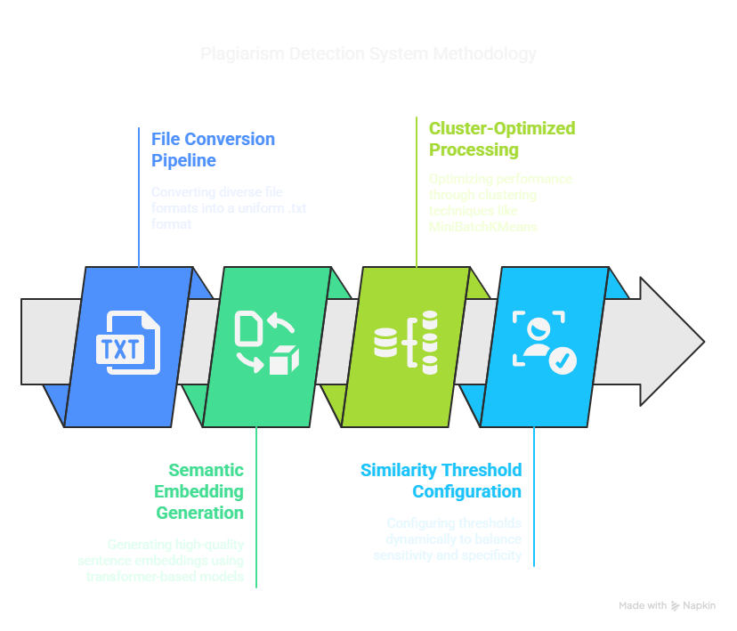

Slide 4
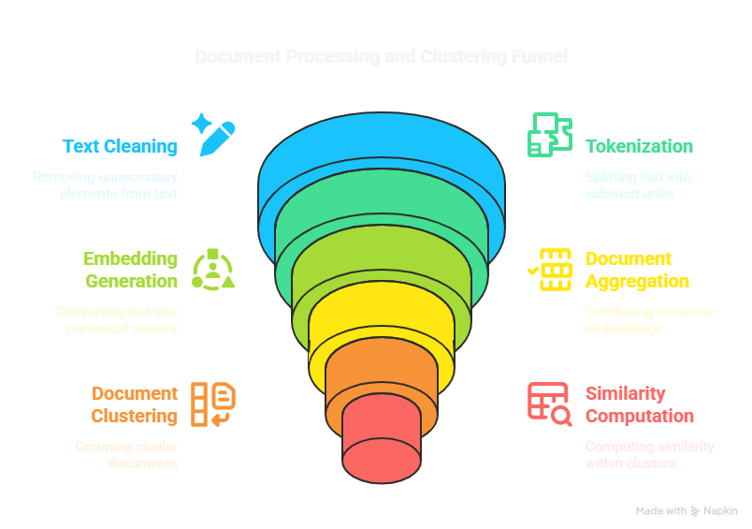

Slide 5
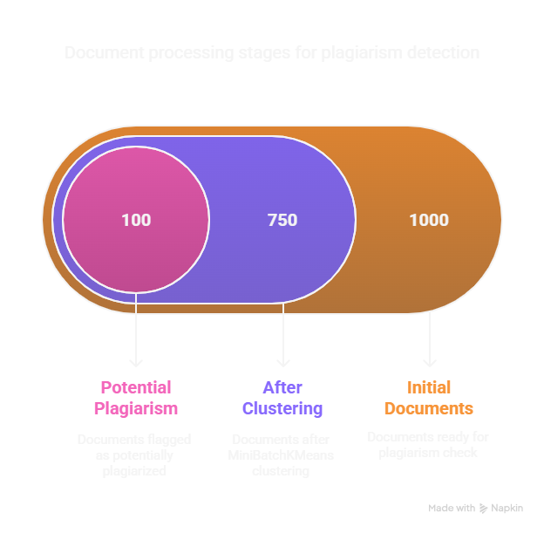

Slide 6
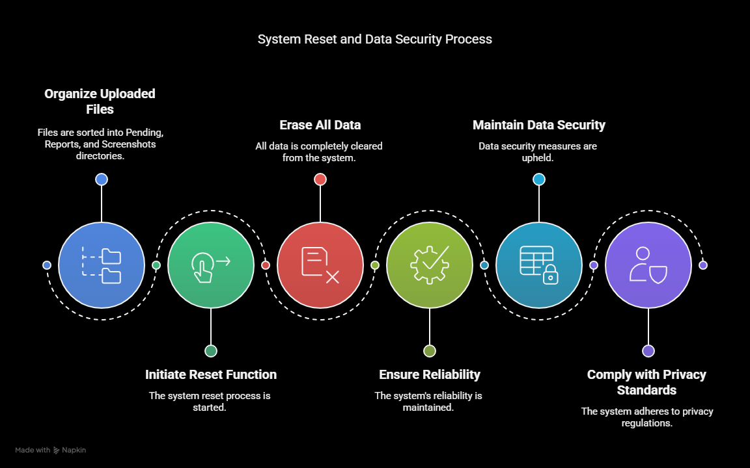

Slide 7
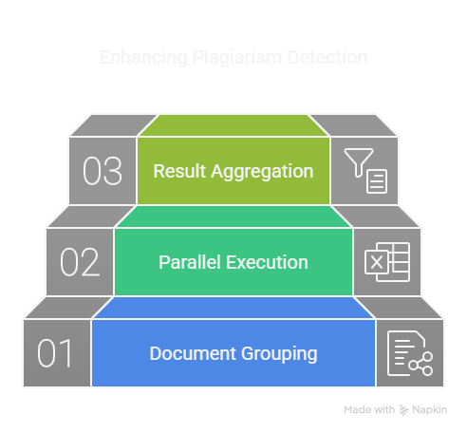

Slide 8
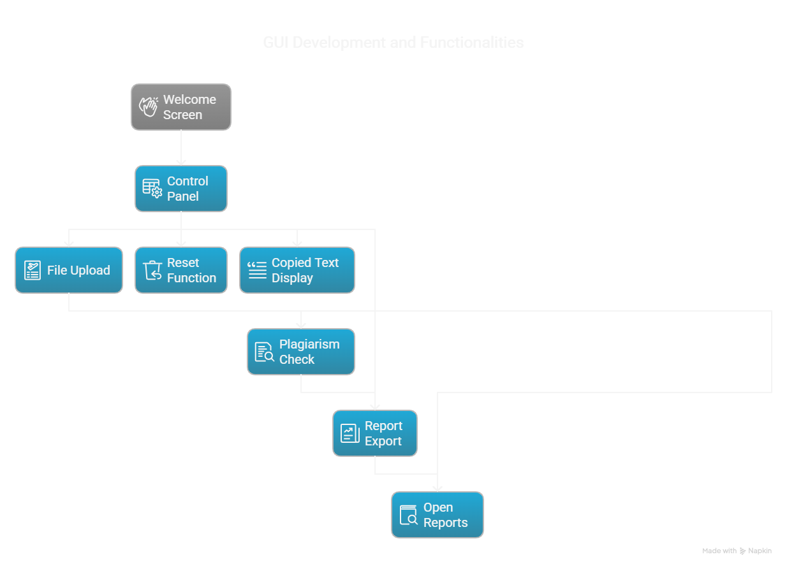

Slide 9
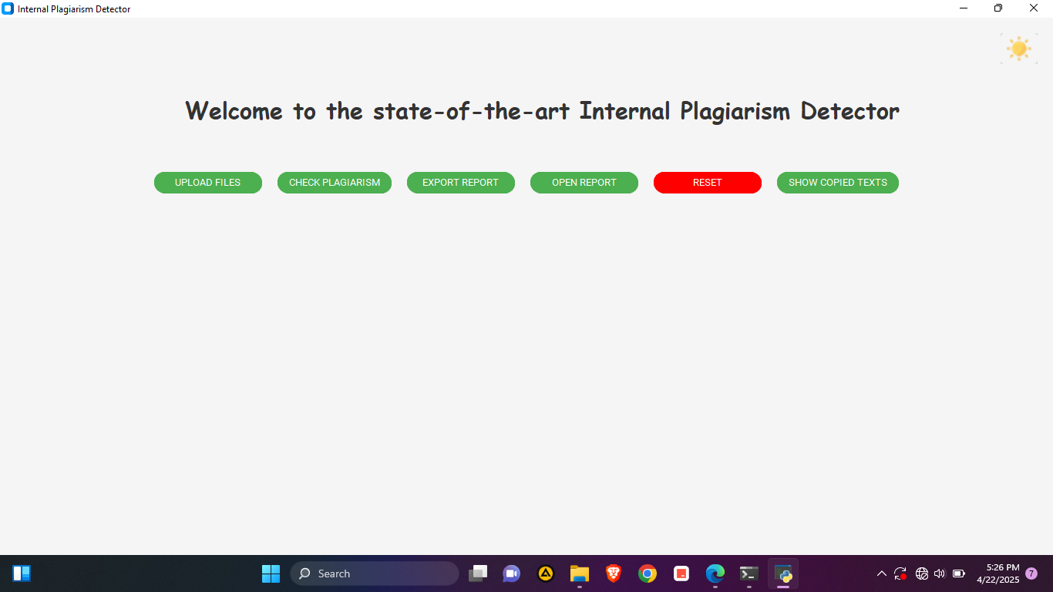

Slide 10
